Slide 1



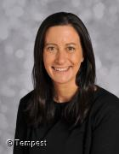
Thursday 27th June 2024
Cheriton Fitzpaine Primary School
School Newsletter
Our annual parent survey has now been analysed by governors and they have written a short summary report of the main findings from what you shared with us. This has been immensely helpful to us in shaping our priorities for next year through the Federation Development Plan and the school plans that are now being written by Heads and their staff teams. The report is attached to this week’s newsletters but the headlines of what you would like us to do are:
Securing wrap around provision for all schools and increasing the breadth and access to after school clubs for all children to enjoy
Managing the small number of children with additional needs and accessing additional funding to improve SEND provision
Developing and sustaining the federation-wide sporting and culture events, including sporting competitions and festivals, musical performances, concerts and shows
We will continue to work on these during the coming year and share with you the events as next year unfolds. We already have some plans for federation-wide events in the coming year, including Showdown in the spring term.
​
The end of the summer term is always busy, and this week has certainly been that! On Wednesday afternoon it was really lovely to see Beech teaching their favourite game (Castles!) to the children in Oak. It was great fun, with lots of squeals of laughter and a far amount of competitive spirit (and that was just the teachers!)
Thursday was a fantastic day for all children in Beech. Y5s headed to QE for a Quogwarts transition event with other children from local primary schools. They enjoyed making slime and wands, playing a game of Quidditch and participating in a herbology class. Meanwhile Y6 headed to Sandford for a transition event with children from Newton St Cyres, Sandford and Brampford Speke. They enjoyed taking part in a first aid session, drama session, campfire and monoprinting art masterclass. As always, the children have been fantastic, throwing themselves into all the activities and mixing well with the other children.
I am delighted to be in a position to share the teaching teams for next year.
Maple: Mrs May and Mrs Moore
Ash: Mrs Woolacott and Mrs Heathershaw
Oak: Mrs Parkes and Mr Nichols
Beech: Mr Perkins and Mrs Theedom
Please remember tomorrow is a Staff Development Day so school is closed for all pupils.
From Mr Jolliffe
Executive Head
From Mrs Theedom
Head Of School
YEAR SIX CELEBRATION DAYS
It has been great to see the Year 6s from the different schools coming together over the last two days to share a range of learning experiences that will prepare them for the next stage of their learning journey and beyond. The children have been based at Silverton and Sandford schools and have worked together on a range of projects including art, games, outdoor learning, first aid training and an opportunity to reflect on their transition to secondary school. Many thanks to everyone who led groups throughout the two days and to Mrs Powell for organising the day and, of course, to all the parents who helped by bringing their children to the host schools.
CAREER TALKS FOR YEARS 5 and 6
Our eldest children have enjoyed hearing about three different careers on Monday afternoons and we are looking forward to a series of talks in the autumn. However, at the moment we do not have anyone who works in primary education talking to the children so if you are a teacher, TA or other member of staff in a school outside the federation, we would love to hear from you. Please contact Mr Jolliffe via your child’s school office if you are able to help with a talk on a Monday afternoon in the autumn or spring terms.
STAFF DEVELOPMENT DAY
A final reminder that tomorrow, Friday, 28th June, is a Staff Development Day and all the federation schools will be closed for staff training. We look forward to seeing the children back at school on Monday, 1st July.
LORDS MEADOW SPORTS SESSIONS
The final session at Lords Meadow this year will now be on Friday 19th July. This is because of the Staff Development Day on Friday, 28th June, the general election on Thursday 4th July, and the circus day on Friday 12th July.

Slide 2


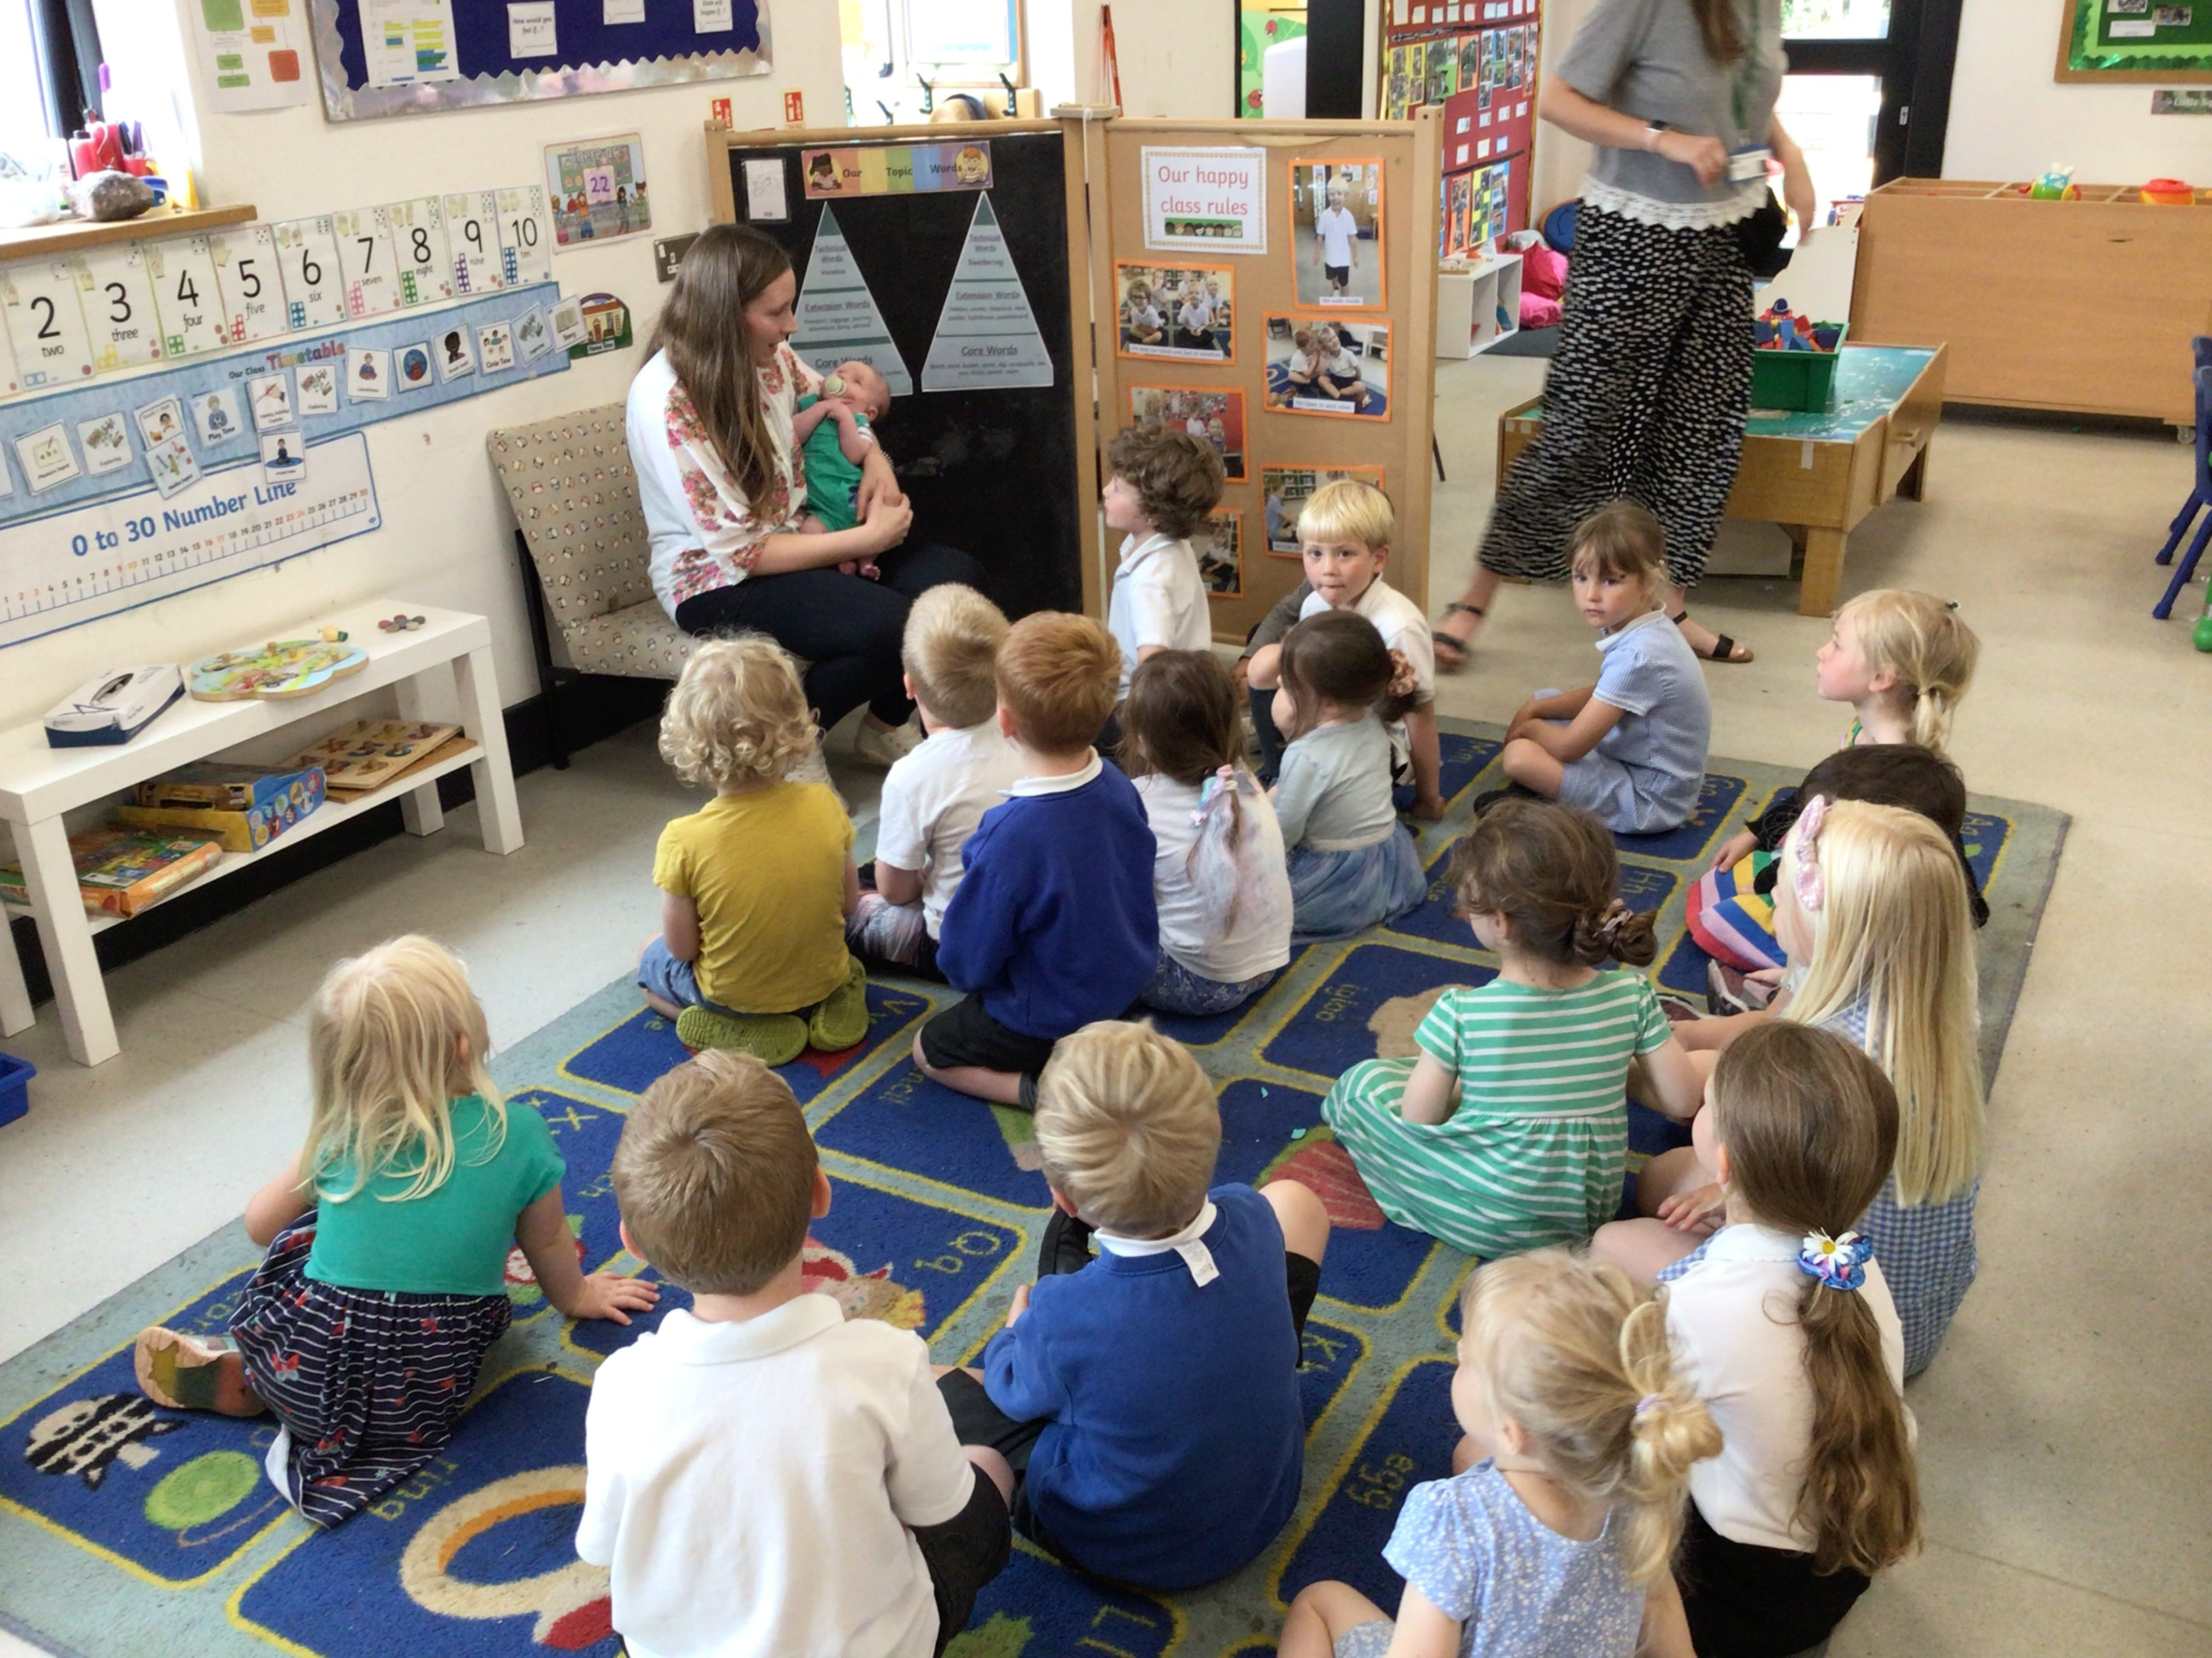
What’s On Week commencing 1st July? (Please see School club Summer Term timetable for further club details)
Date | Breakfast Club | P.E | What’s On | Who does it involve? | Music Lesson | Clubs 3.30-4.30
Monday 1st July |  |  |  |  | Alison Golby | Band Tag Rugby
Tuesday 2nd July |  | Beech & Oak | Class-led Outdoor Learning Tag Tournament | Ash Selected Teams | Francisca Van Holthoon | Drama Club
Wednesday 3rd July | 8-9am | Maple | Class-led Outdoor Learning New Reception Parents Meeting 2:30pm | Beech Reception Parents 24/25 | Sarah Wheatley | Choir Club
Thursday 4th July | 8-9am |  | Tuck Shop Sports Day 9.30am | All N-Y6 |  | Dance Club
Friday 5th July |  | Oak, Beech, & Ash |  | Ash |  | Rounders and Cricket
Communications Board
Class-led Outdoor Learning
Children in Ash and Beech will be enjoying some outdoor learning every week. Please can children bring a pair of wellies or spare shoes and an outdoor coat on these days. Oak class will be replacing outdoor learning on a Friday with PE, unless otherwise stated.
Hot Weather
Now the weather is warming up, please can parent/carers send children to school with sunscreen applied. Please also supply extra sunscreen to be applied throughout the day, and a summer hat. Many thanks
Mrs Ferbrache came to visit
It was lovely to see Mrs Ferbrache drop in with baby Kaleb on Tuesday afternoon. The children loved meeting him (as did the staff!)
Did you know?
Our online calendar has all our key dates as well as any additional information, letter and consent forms, and can be found here:
Exe Valley Federation - Diary Dates
SCHOOL CALENDAR DATES
Monday 8th July | Sandford Cricket Festival (Selected Team)
Wednesday 10th July | RESERVE sports day
Thursday 11th July | Transition Day
Friday 12th July | Circus Day Reports
Wednesday 17th July | KS2 Production “Olivia”
Thursday 18th July | Summer Celebration & Y6 Sleepover
Friday 19th July | EVF Cross Country (selected Team) Final LMLC for Ash
Wednesday 24th July | Y6 Leavers’ Meal
Thursday 25th July | Leavers’ Assembly- 2.15pm Last Day of Term
Useful Links
School Meal Menu
Term Dates
Club Timetable
Pick N Mix
homework
Parent Handbook
School Gateway

Slide 3
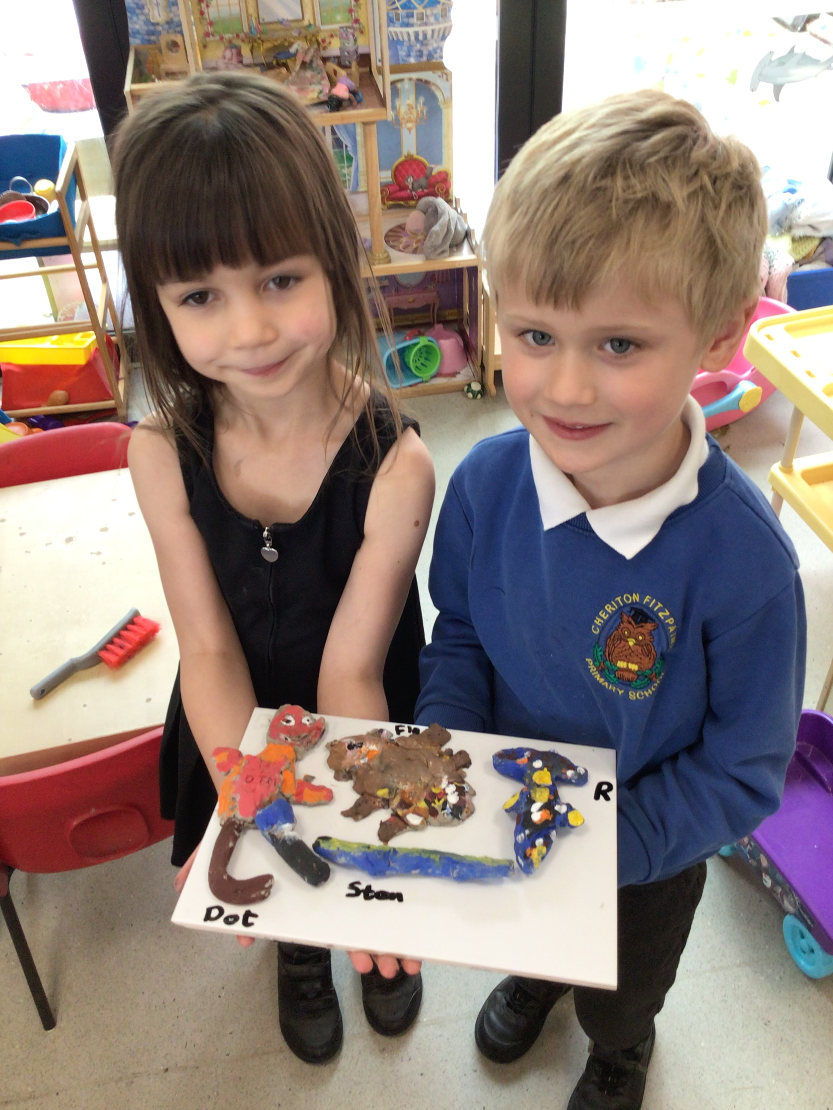
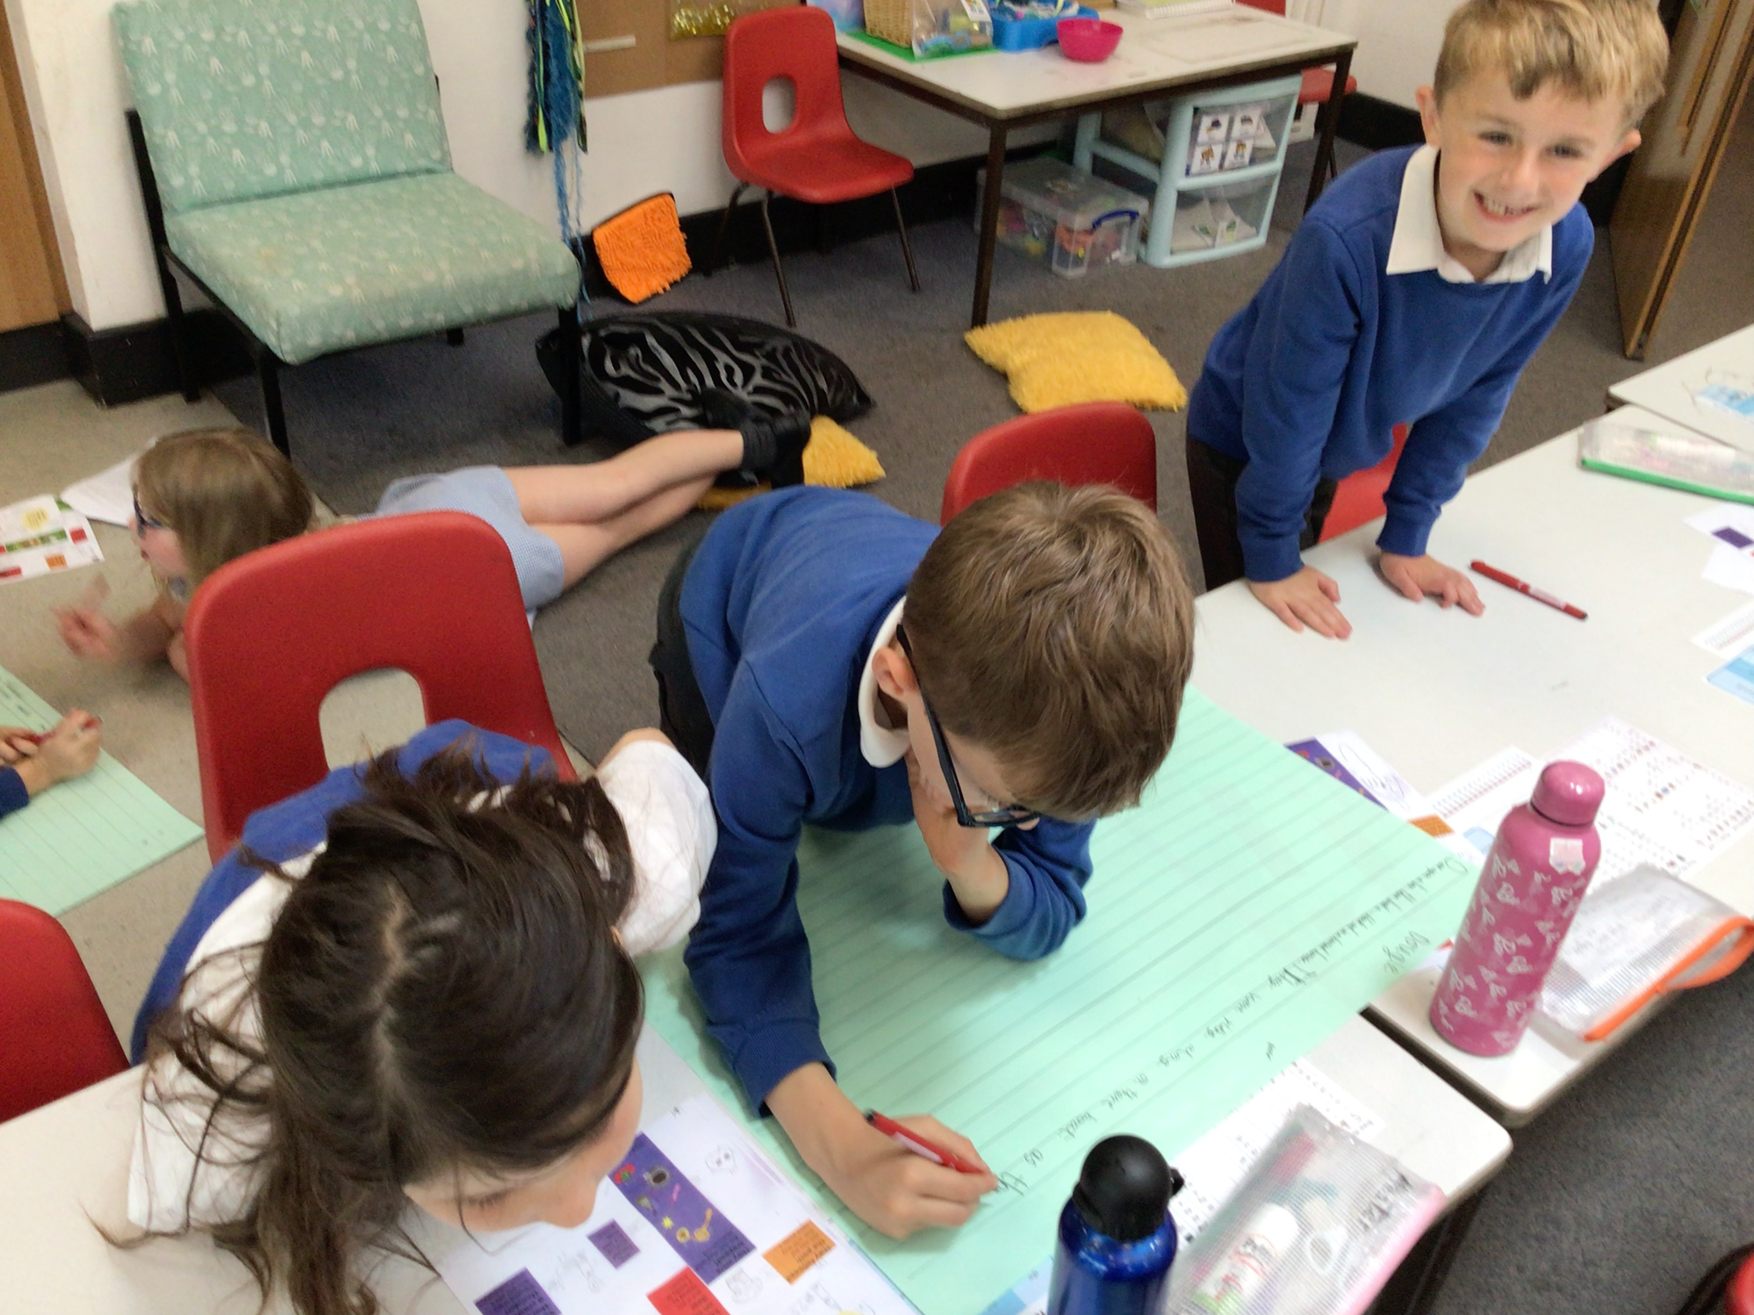
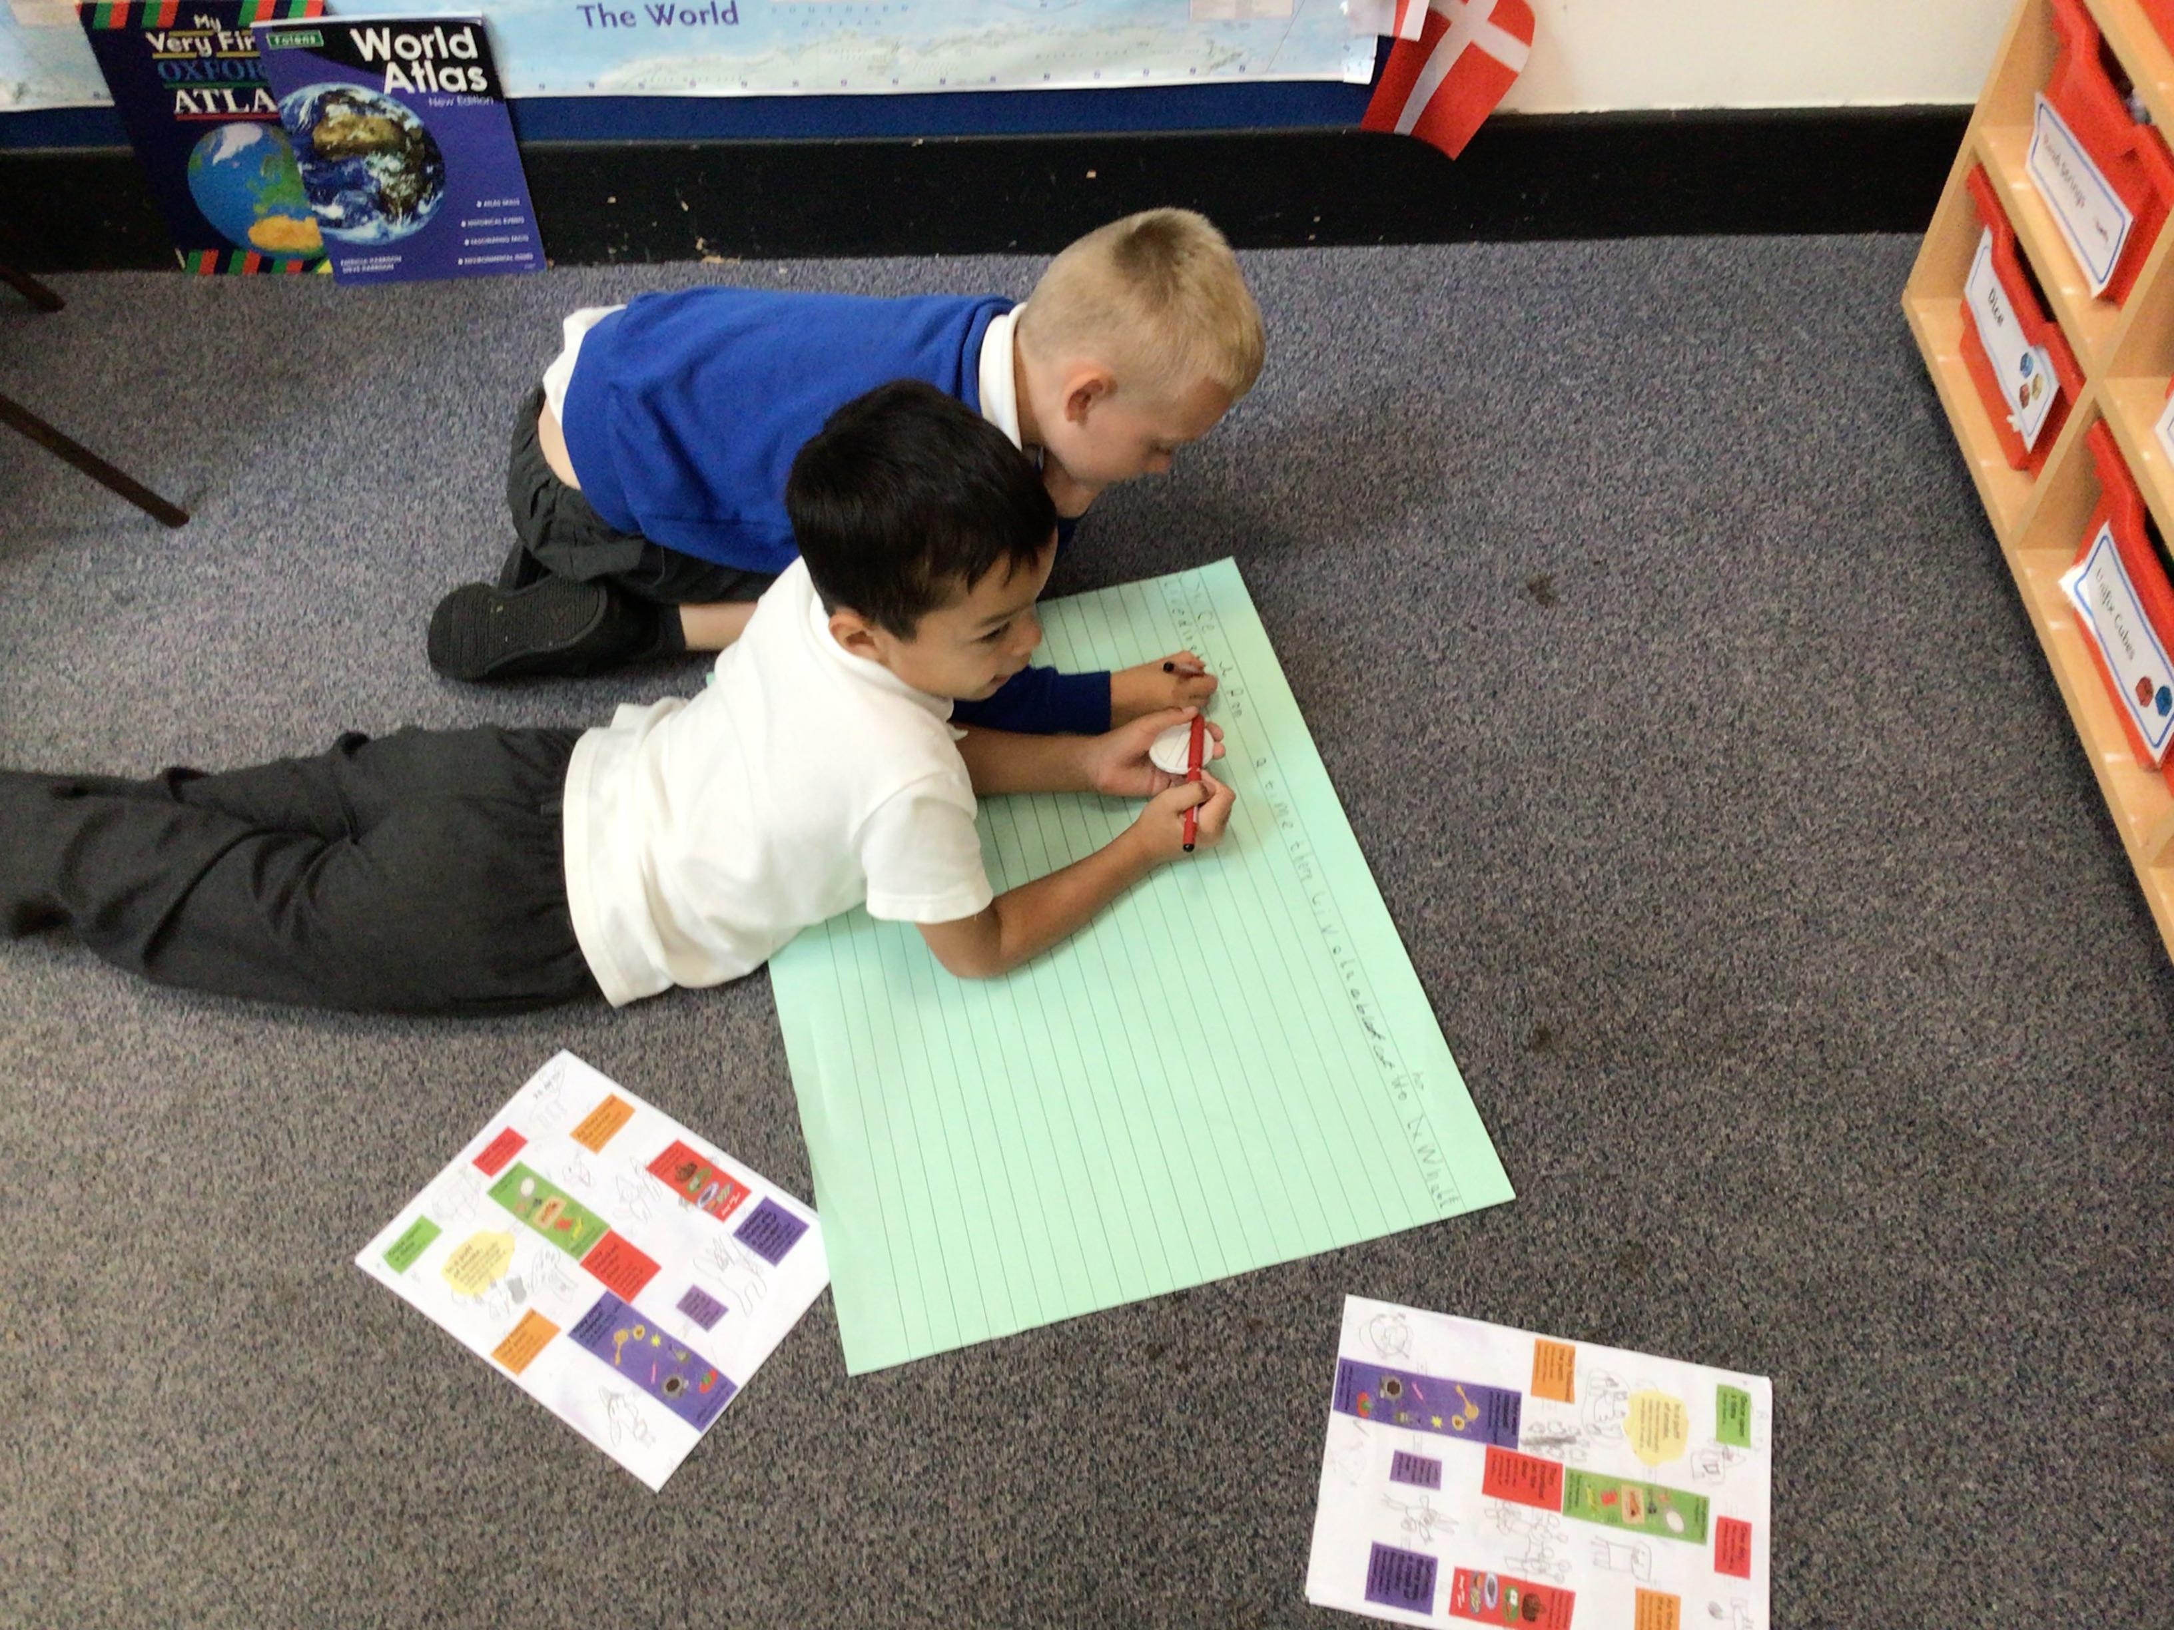
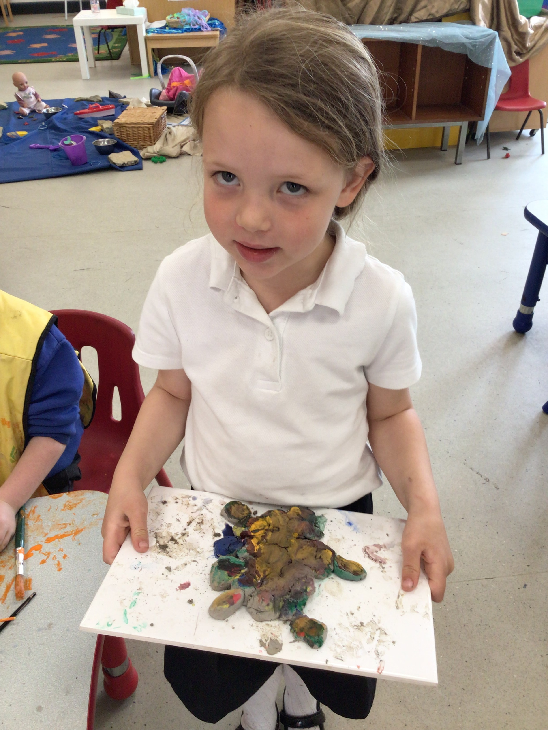
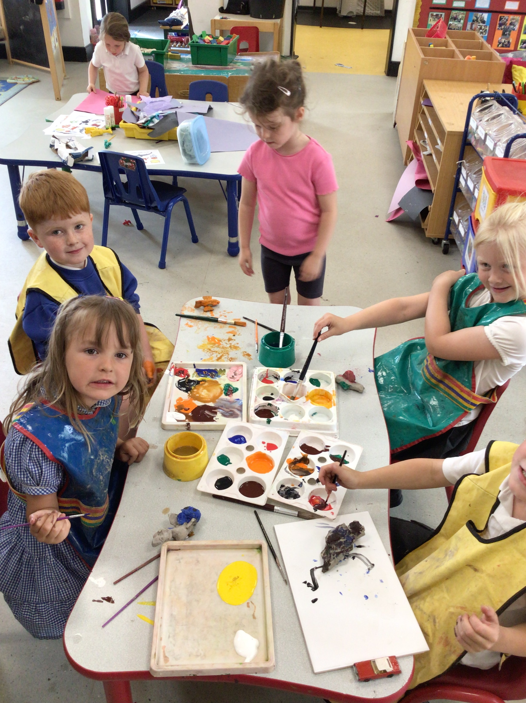
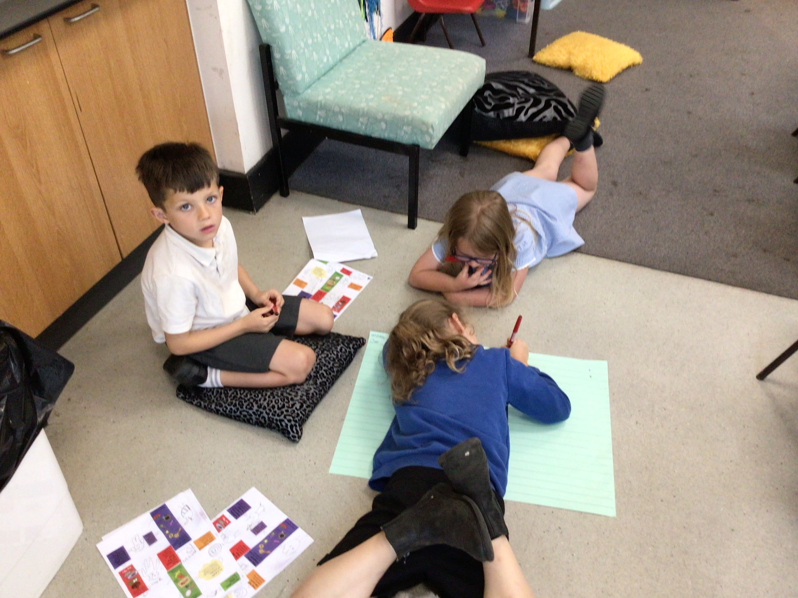
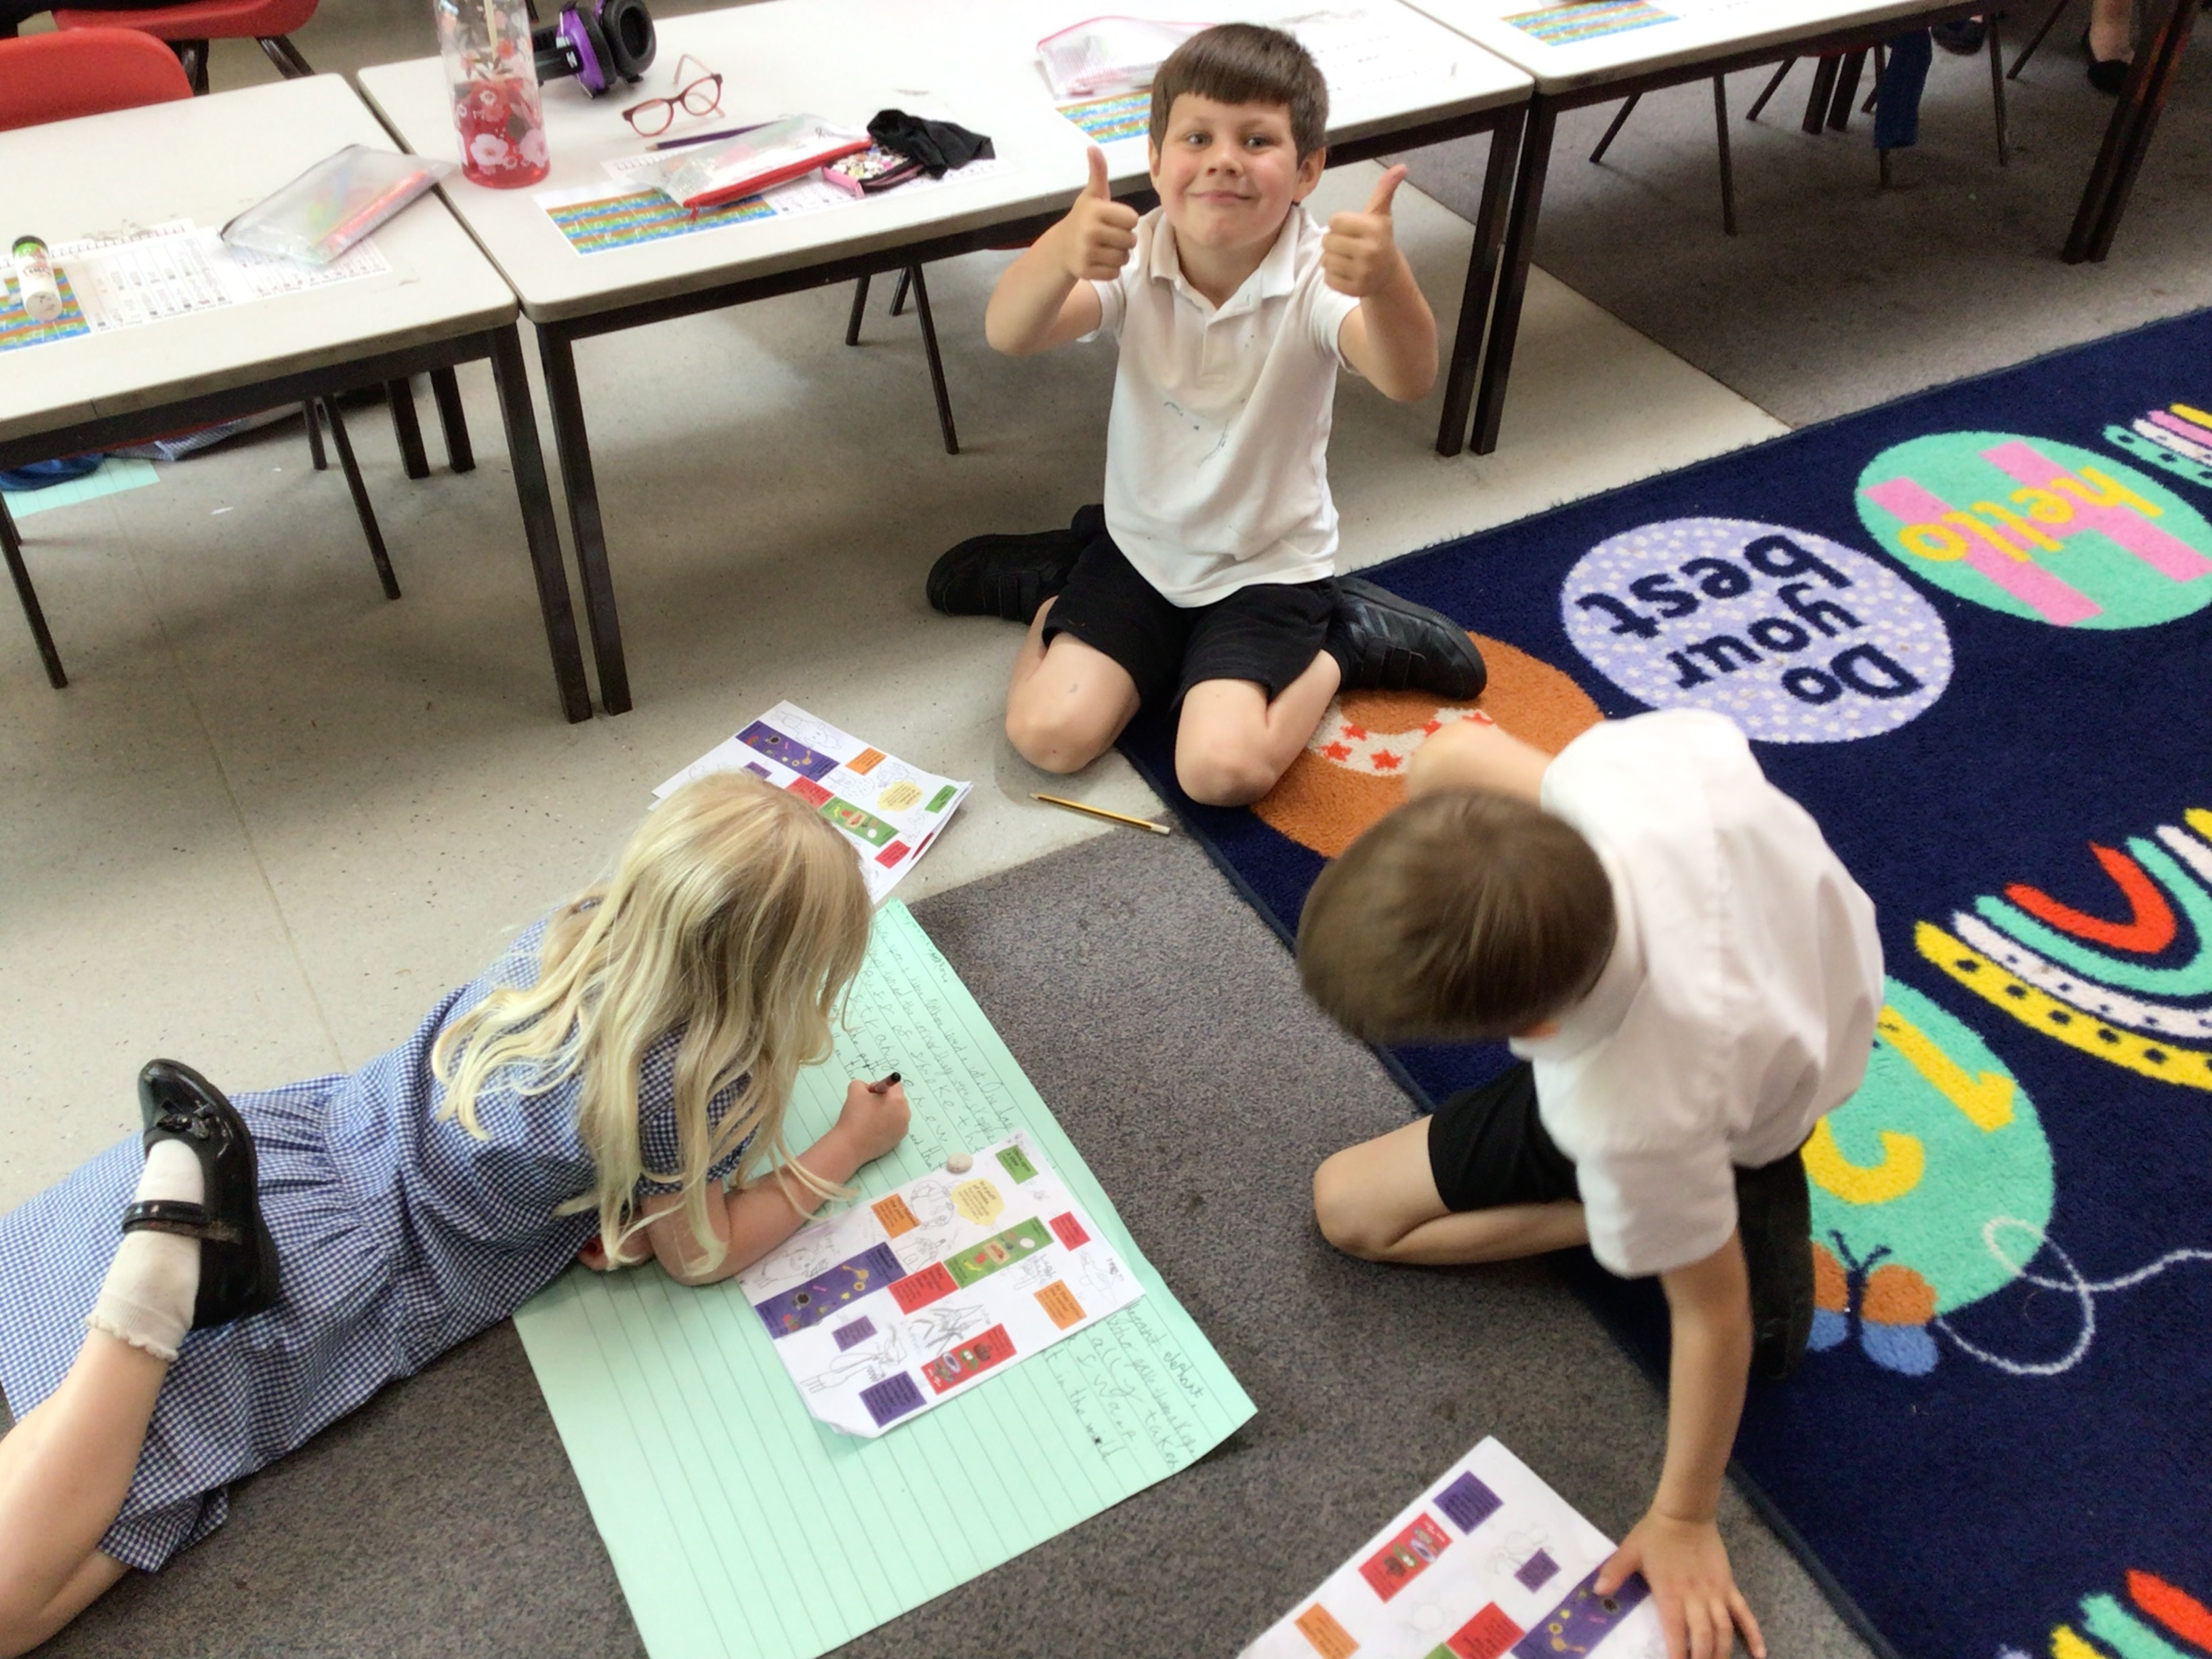
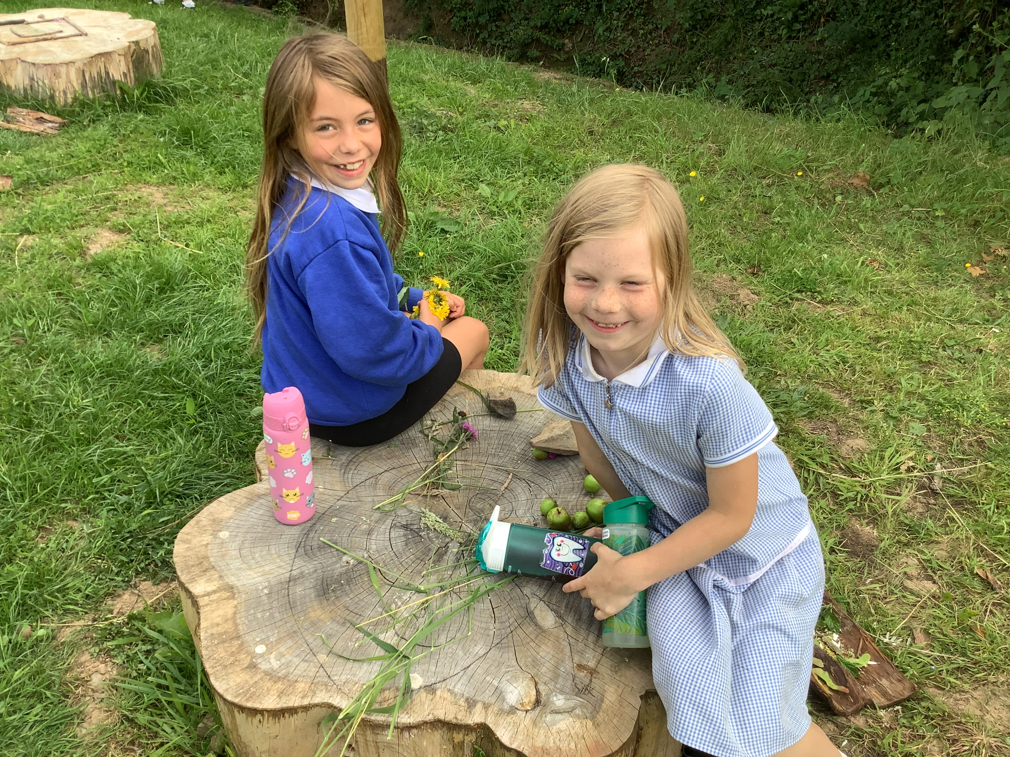
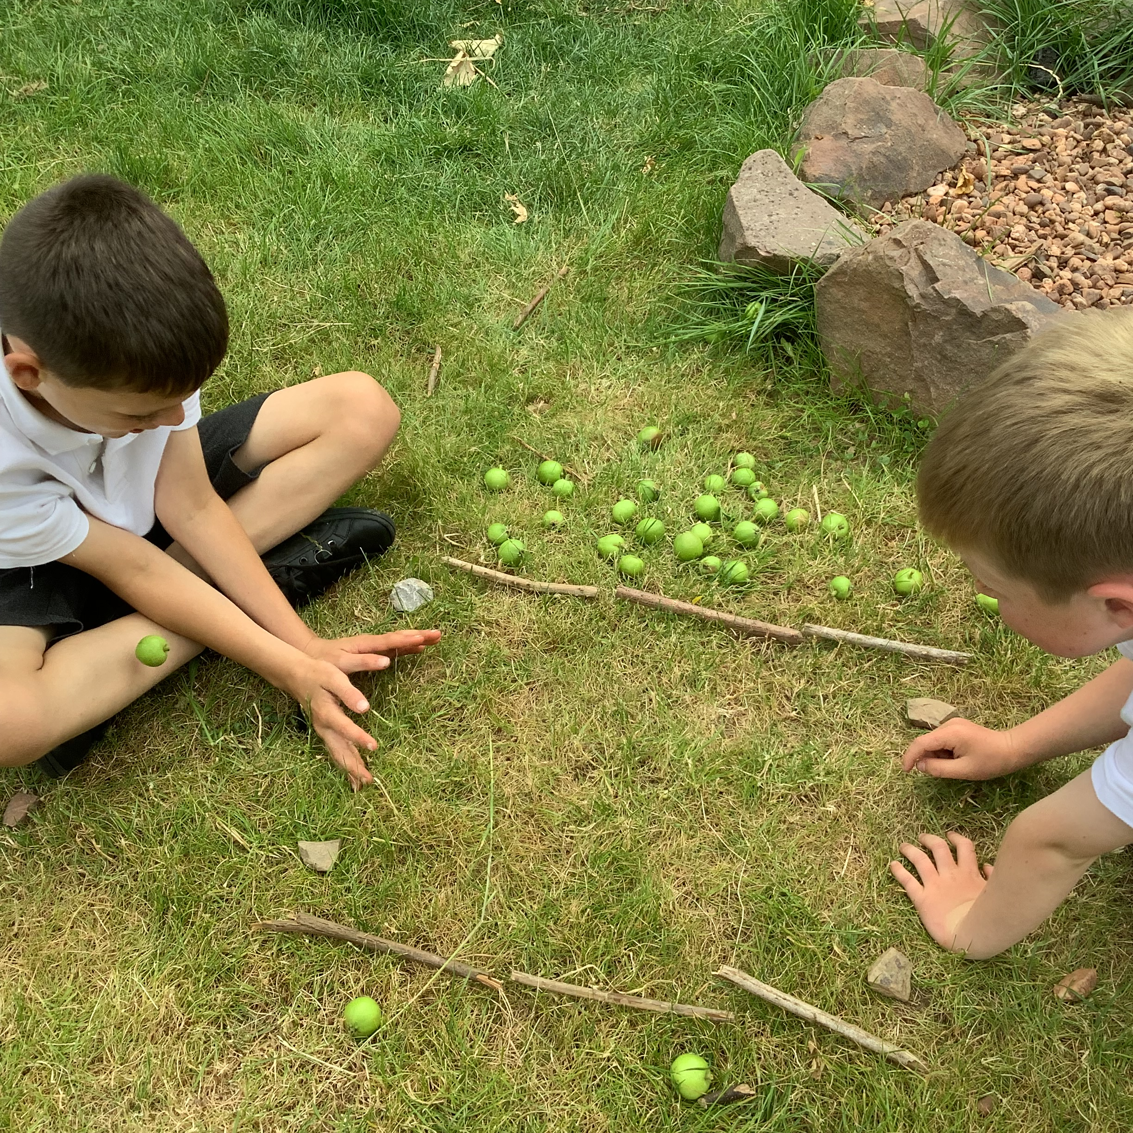
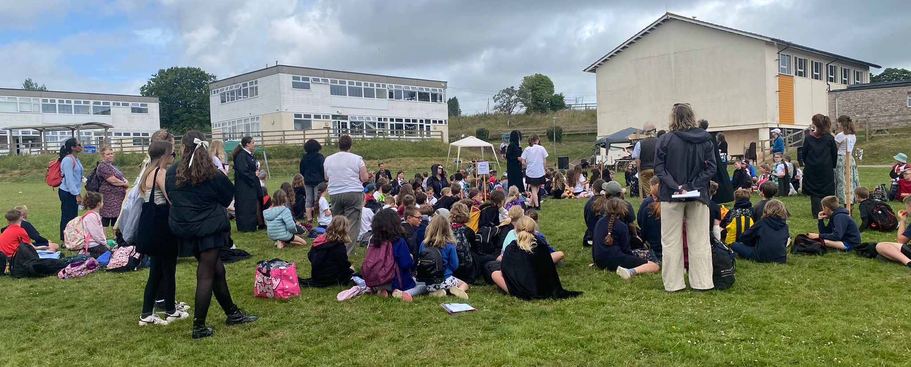
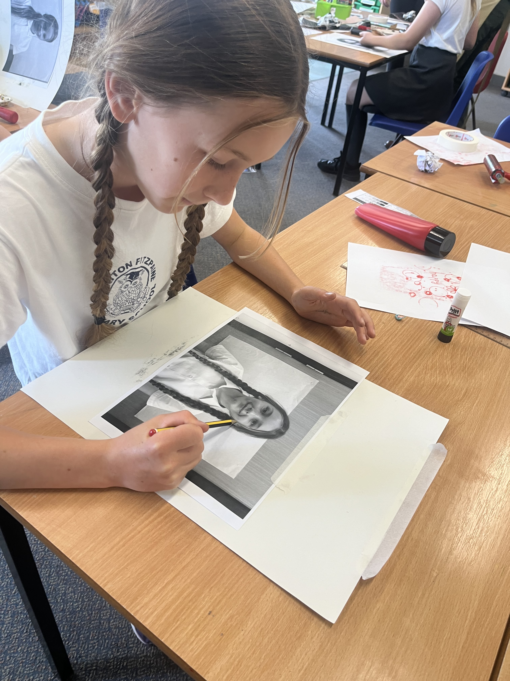
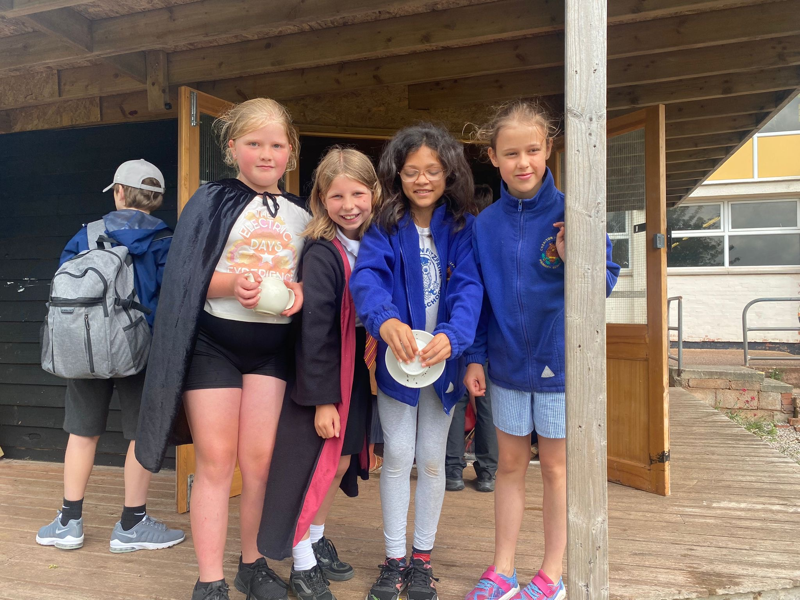
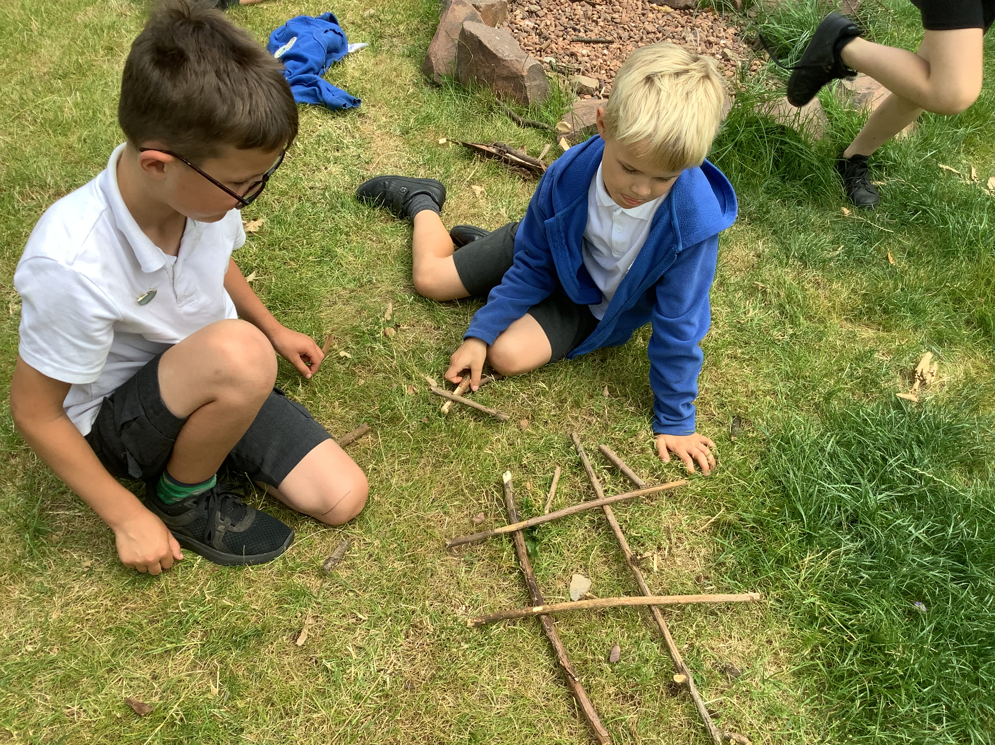
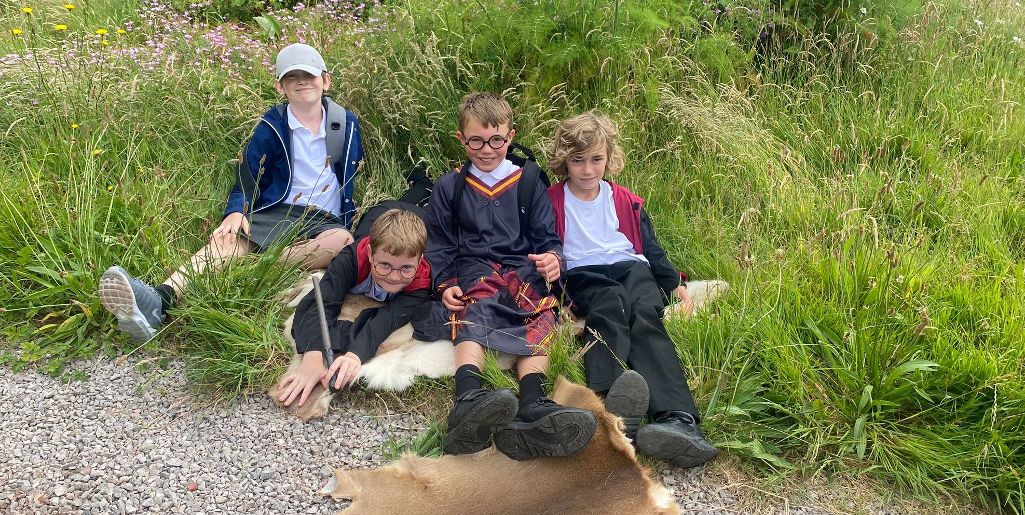
Maple
Reception have been slip, scoring and blending to make their clay sea creature models. The look fantastic!
Ash
In English Ash Class have been creating a piece of shared. They have also been sharing a new text called “Story Path” where the class gets to choose a different element to guide where the story goes!
What have we been learning this week?
Oak
Oak class have enjoyed an outdoor learning session, creating games using only what they could source outside!
Beech
An eventful day for Beech class today. Year 5 have been having a spellbinding day at QE for their Quogwarts day, and Year 6 have been divulging in an array of activities on their Celebration Day at Sandford school

